Slide 1
Finite Automata
Automata Theory
Ege University
Department of Computer Engineering
2010-2011 Fall
Yrd. Doç. Dr. R. Cenk Erdur, 2010

Slide 2
Definition
Finite automata consists of a set which includes states, and transitions between these states according to the external inputs.
Yrd. Doç. Dr. R. Cenk Erdur, 2010

Slide 3
Deterministic Finite Automata
Deterministic finite automation is the one that is in a single state after reading any sequence of inputs. The term deterministic refers to the fact that on each input there is one and only one state to which the automation can pass from its current state. In contrast, “non-deterministic” finite automata can be several states at once.
Yrd. Doç. Dr. R. Cenk Erdur, 2010

Slide 4
Formal Definition
A deterministic finite automation is defined by a five-tuple; M=(Q, Σ, f, s, F) .
  Q: A finite set of states.
  Σ: A finite set of input symbols.
  f: Q x Σ → Q: A transition function that takes as arguments a state and an input symbol and returns a state.
  s ∈ Q : Start state.
  F ⊆ Q : A set of final states.
Yrd. Doç. Dr. R. Cenk Erdur, 2010

Slide 5
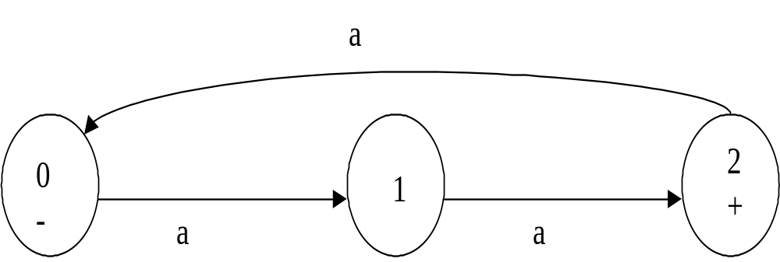
Question
For the finite automata given below, write the components that constitute the formal definition given in the previous slide.
Yrd. Doç. Dr. R. Cenk Erdur, 2010

Slide 6
Another Definition for Finite Automata
Language Recognizer:
  Finite automata models work by being presented with an input string of letters that it reads letter by letter. The set of all strings that leave the automation in a final state is called the language defined by the finite automation. The strings that do not leave the finite automation in final state are not accepted; they are rejected.
Yrd. Doç. Dr. R. Cenk Erdur, 2010

Slide 7
Representations
Finite automations can be represented in two ways:
  Transition Diagram
  Transition Table
As an example, the representations for the finite automation that accepts the language defined by the regular expression (a+b)*b(a+b)* are shown in the following slides.
Yrd. Doç. Dr. R. Cenk Erdur, 2010

Slide 8
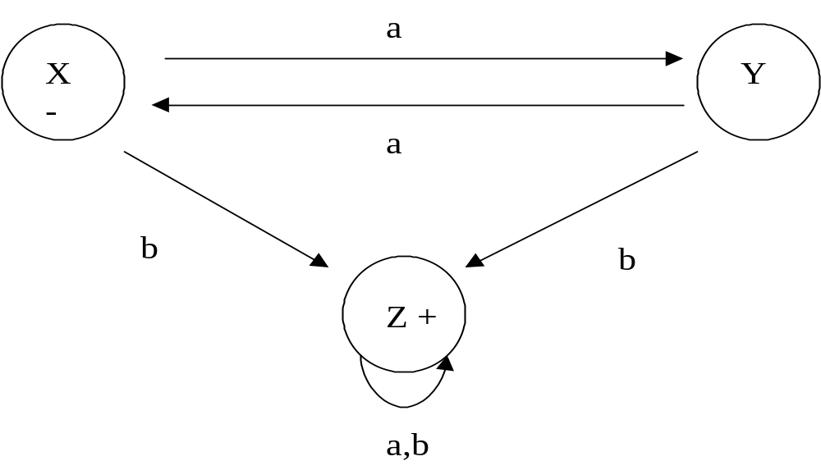
Transition Diagram
Yrd. Doç. Dr. R. Cenk Erdur, 2010

Slide 9
Transition Table
a
b
X (Start)
Y
Z
Y
X
Z
Z (Final)
Z
Z
Yrd. Doç. Dr. R. Cenk Erdur, 2010

Slide 10
Example-1
Build a FA for the language (a+b)(a+b)*
a,b
a
-
+
b
or
a,b
-
a,b
+
Yrd. Doç. Dr. R. Cenk Erdur, 2010

Slide 11
Example-2
Build a FA for the language (a+b)* .
a,b
+
-
Does it accept Λ “Null” ?
Yrd. Doç. Dr. R. Cenk Erdur, 2010

Slide 12
Example-3
Can a FA model be disconnected?
-
a,b
2
3
b
+
The above model cannot be accepted as a FA.
Yrd. Doç. Dr. R. Cenk Erdur, 2010

Slide 13
Question
Describe the language accepted by the FA given below.
a,b
-
a,b
2
a,b
+
Yrd. Doç. Dr. R. Cenk Erdur, 2010

Slide 14
Example-4
R.E.: a(a+b)* is given. Build a FA for this language.
a,b
a,b
2
2
b
b
-
-
a,b
a,b
a
3 +
a
3 +
a,b
4 +
Yrd. Doç. Dr. R. Cenk Erdur, 2010

Slide 15
Example-5
Build a FA that accepts only “Null”.
a,b
+
-
+
-
a,b
OR
Yrd. Doç. Dr. R. Cenk Erdur, 2010

Slide 16
Question-1
R.E.: (a+b)*aa(a+b)*
“Language of words that have a double a in somewhere” is given.
Build a FA for this language.
Yrd. Doç. Dr. R. Cenk Erdur, 2010

Slide 17
Question-2
Let Σ={a,b}. L is the set of all words that do not contain two consecutive a’s. Write a regular expression and build a FA for this language.
Yrd. Doç. Dr. R. Cenk Erdur, 2010

Slide 18
Question-3
L:The language of words that have different first and last letters.
Build a FA for the language L.
Yrd. Doç. Dr. R. Cenk Erdur, 2010

Slide 19
Question-4
L: All strings in which the letter a is never tripled. This means no word contains the substring bbb.
Write a regular expression and a build a FA for the language L.
Yrd. Doç. Dr. R. Cenk Erdur, 2010

